Slide 1

Nosferatu
We will Hash Slinging Slash your electric bill
By: Gunnar Boehm, Dan Cardin, Joe Gorse, Connor Igo, Chris Holtsnider,
Advisor: John Kimani
2015 EECE Capstone

Slide 2
The Problem
Forgetting to turn your lights off when you leave your house
Needing to get out of your comfortable bed to turn off lights
Bumping into furniture on your way to the bathroom late at night

Slide 3
Introduction
Nosferatu is an energy efficient, convenient new way to control your home lighting. Bringing Wi-Fi and motion sensors to your light switches allows you to set schedules and rules to manage your home lighting, as well as save money, energy and time.

Slide 4
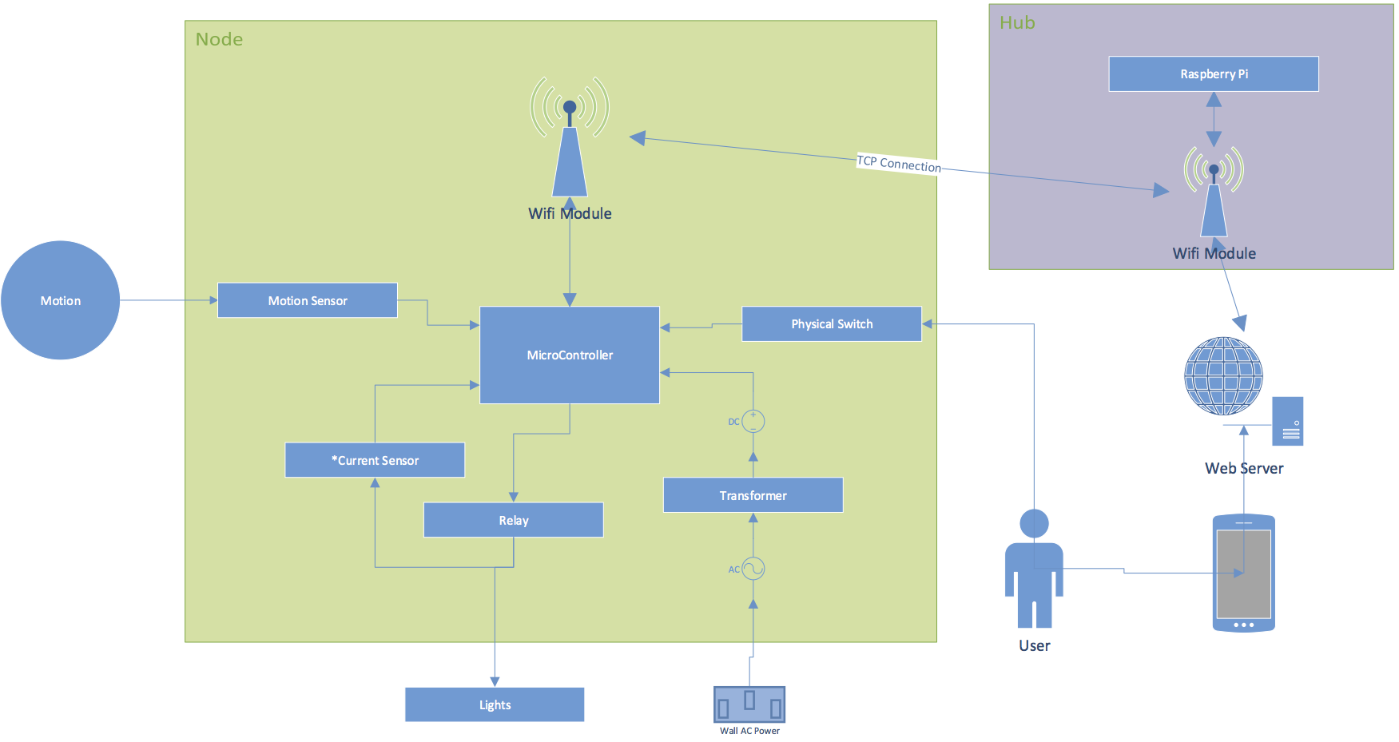
Hardware Layout
Notes:
Need to update this chart: Server is on Rpi, not external. Joe doesn’t have Visio so can someone else do that?

Slide 5
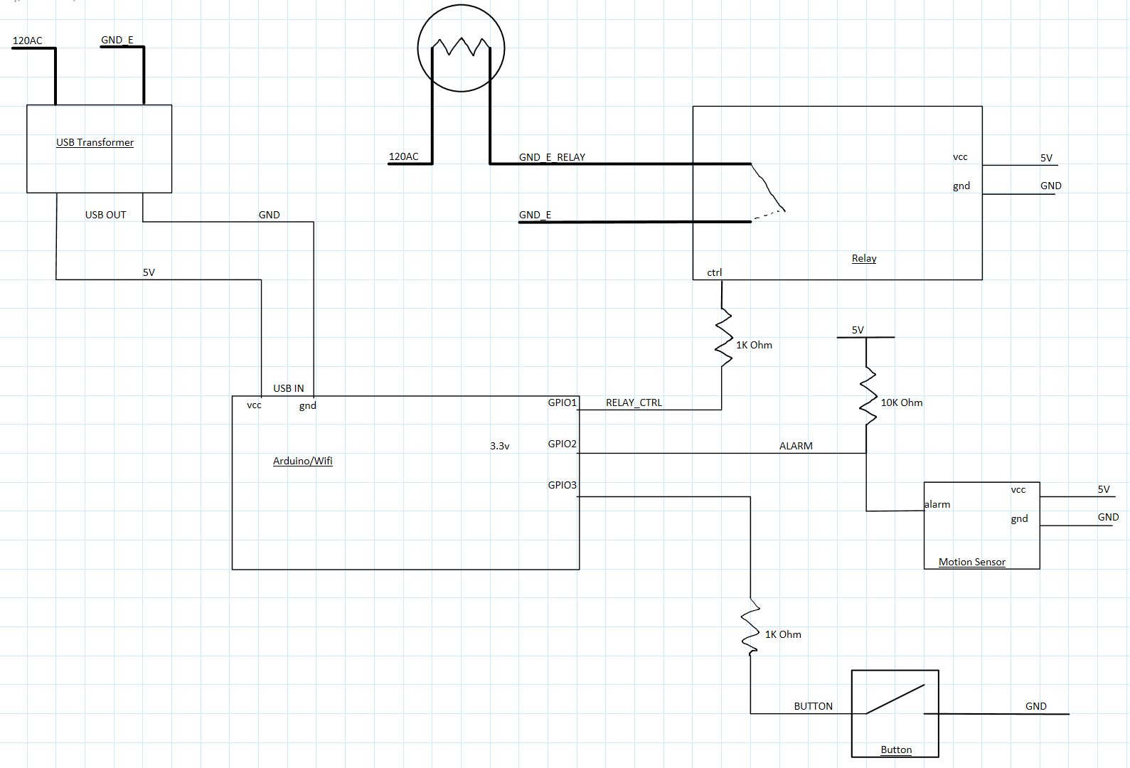
Hardware Schematic

Slide 6
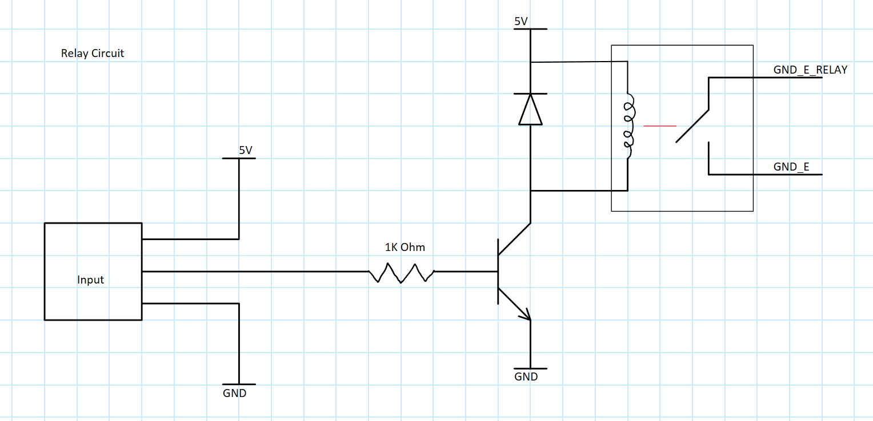
Relay Schematic

Slide 7
Build Process
Notes:
Need to add some pictures of the project- Rpi, node fully set up, maybe screenshots of web UI?

Slide 8
Firmware
Developed with Arduino IDE
C/C++ Based
Built in WiFi to board utilize multiple user libraries
Digital control over all I/O such as:
Relay to control lights
Motion Control
Manual Control
Built in file system
Used to store files for backup, or hosting more advanced forms
LUA and Micro Python interpreters for scripting

Slide 9

Initial User Setup
If Node is not paired a basic webpage will be hosted for the user to input the SSID and Password of the connection point

Slide 10
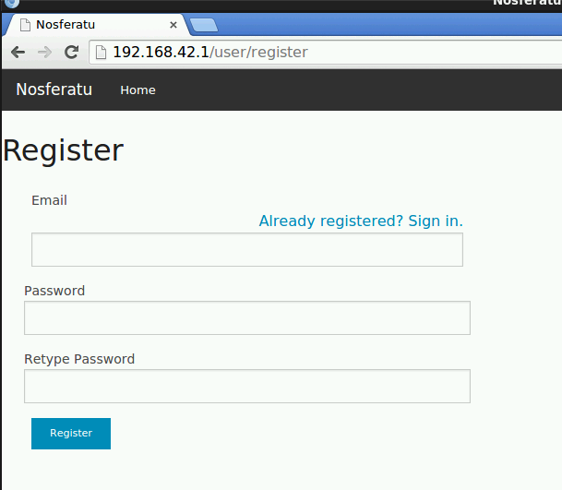
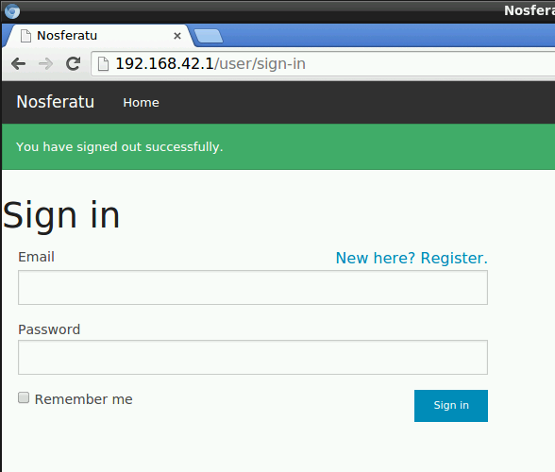
Front End (UI)
gorsejoe@gmail.com
************

Slide 11
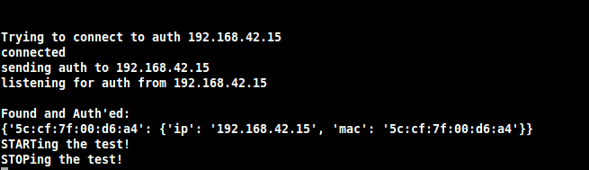
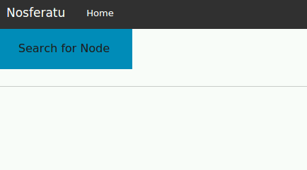
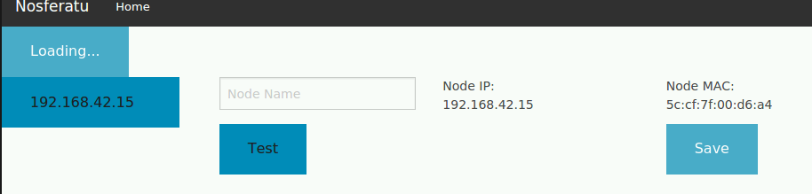
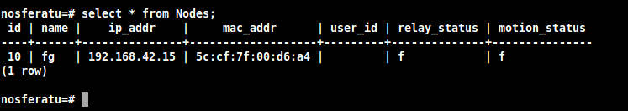
Frontend (UI)
continued…

Slide 12
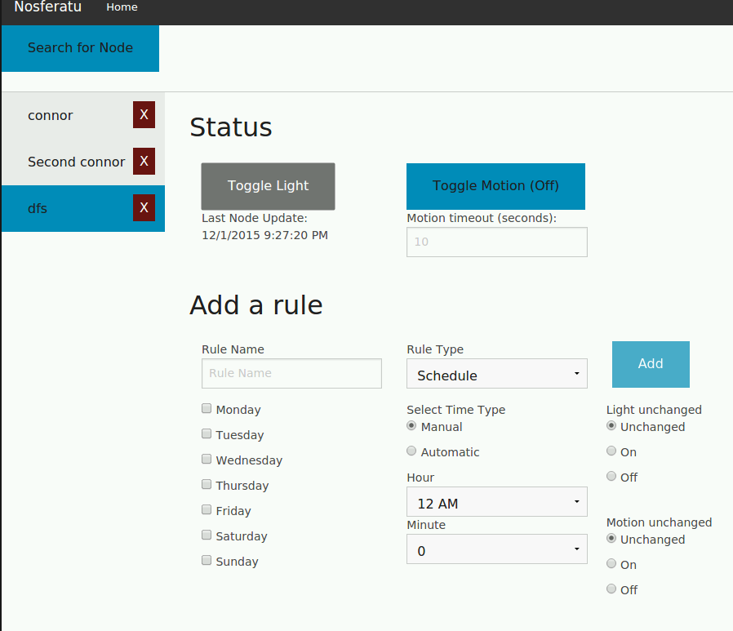
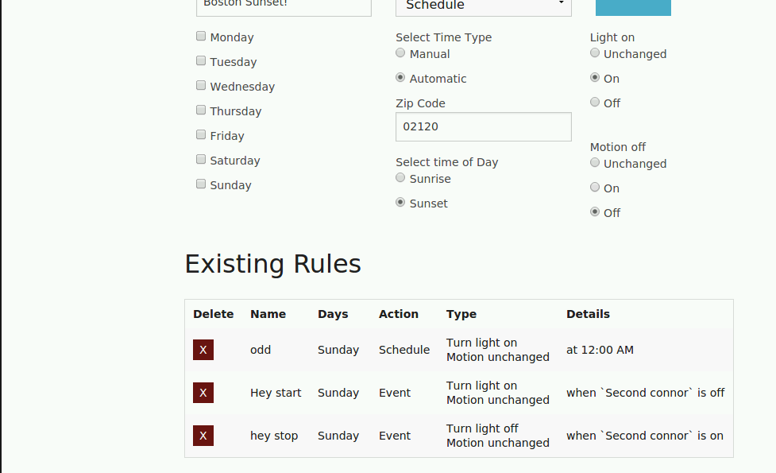

Frontend (UI)
continued…

Slide 13
Changes
Switched from Arduino Pro Mini with an ESP8266 module to a NodeMCU

Slide 14
Conclusion
Nosferatu is cheaper than the competition
Nosferatu is easier to use
Nosferatu is the most convenient way to manage your home lighting
Thank you to our advisor, John Kimani, for your guidance and support

Slide 15
Questions?

